Slide 1
SRIP, IITGN Week 1
Post-processing of atomistic simulation data using python and setting up a deep-learning model for inverse design of 2D materials based heterostructure Kaxit Pandya
Under Guidance of Dr. Tarun Agrawal

Slide 2
Post-processing of atomistic simulation data using python and setting up a deep-learning model for inverse design of 2D materials based heterostructure
Inverse design of 2D materials refers to the process of using computational techniques, often based on machine learning and optimization algorithms, to predict the atomic structure and properties of 2D materials with desired functionalities. A heterostructure is a structure composed of two or more different semiconductor materials, layered together in a specific order. Ex. Giving model properties like high conductivity, durability etc and model tells to use combination of materials (Si, Au, GaAs) through which it can be done. Heterostructures can be classified as either type I, type II, or broken gap heterostructures, it depends on the alignment of the conduction band minimum (CBM) and valence band maximum (VBM) of the materials at the interface.

Slide 3
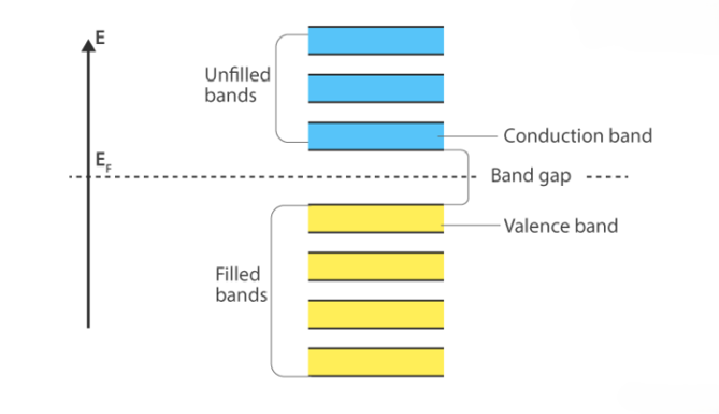
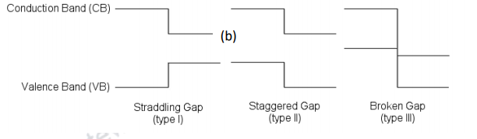
Type 1 heterostructure is the most common. The sum of the conduction band and valence band edge discontinuities is equal to the energy gap difference. Type 2 heterostructure is arranged such that the discontinuities at conduction and valence band have different signs. Type 3: The band alignment is such that the top of the conduction band in one semiconductor lies below the valence band maxima of the other semiconductor.

Slide 4
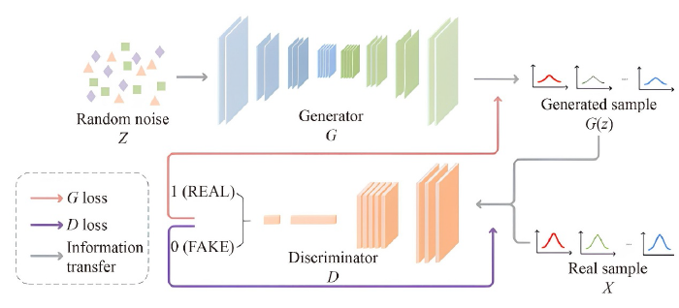
Generative Adversarial Networks (GAN)
GAN consists of a generator G and a discriminator D. The generator is responsible for generating synthetic data samples that approximate the underlying distribution of the real data, while the discriminator is responsible for distinguishing the real and generated data. The generator usually takes
random noise as input, and then the generated sample G(z) is output by mapping the noise to a new data space. On the other hand, the discriminator receives both real data samples from the actual dataset and generated data from the generator as input. The output of the discriminator is a probability score, indicating the probability that the input data is the real data.

Slide 5
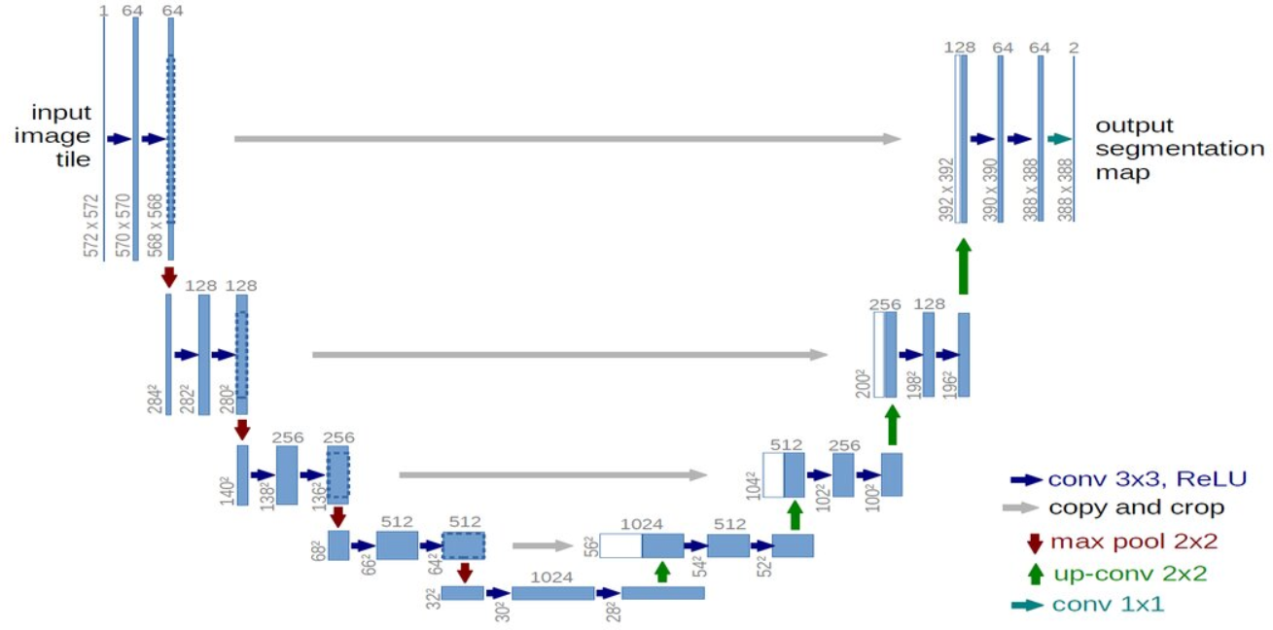
U-NET
U-net is composed of an encoder, a decoder, and a skip connection. The encoder employs convolutional blocks, succeeded by pooling layer for downsampling, to extract feature representations at different hierarchical levels from the input image. Each encoder layer consists of two successive 3 × 3 convolutional layers, a linear activation function, and a 2 × 2 max pooling layer, ultimately diminishing the image to a compact feature map. The purpose of the decoder is to semantically project the lower-resolution features obtained from the encoder into a higher-resolution pixel space, ultimately achieving accurate segmentation.

Slide 6
Most of the papers used GAN, U-NET, CNN /Pre-Trained models (ResNetVGG16), ANN
Defects Identification
Recognition and Classification of Atomic Structures
Material Identification
Thickness Characterization
Distinguish Between Monolayer and Bi-layer
Dataset: Image generated through AFM, TEM, Atomic Force Microscopy (AFM): AFM provides high-resolution topographic imaging, allowing precise measurement of the thickness of 2D materials.
Transmission Electron Microscopy (TEM): TEM can be used to directly visualize the atomic structure of 2D materials. Classification through our Model

Slide 7
References
https://doi.org/10.1007/s11467-024-1394-7
https://byjus.com/jee/conduction-band/
https://ebooks.inflibnet.ac.in/phy12/chapter/formation-of-heterostructure/#:~:text=common%20affinity%20rule.-,4.1.2%20Different%20types%20of%20heterostructures,as%20shown%20in%20Figure%204.2

